Slide 1
College Football Data Collection and Preprocessing
Group Members
Caleb Miller: cm3962@drexel.edu
Muhammad Hazrat: mh3852@drexel.edu
Hashim Afzal: ha695@drexel.edu
DSCI 511 – 003
Dr. Shadi Rezapour

Slide 2

Introduction
This dataset offers a comprehensive view of college football games and teams
This includes scoring details, team information, excitement index, and attendance figures
The data collected is from the 2022 college football season

Slide 3





Purpose of the Dataset
The purpose of this dataset is to analyze factors influencing attendance and excitement in college football games
High scoring vs low scoring
Close game vs blowout
Level of competition (D1, D2, etc.)
The dataset allows the extraction of valuable insights for sports administrators
This can be helpful for strategic planning and enhancing fan experiences

Slide 4
Potential Users and Applications
Sports Analytics: The dataset can be utilized for in-depth analysis of game trends and team performance
Sports Administration: Insights from data can be leveraged to make strategic decisions such as:
Game scheduling
Fan engagement
Marketing strategies
Academic Research: Helps understand the impact of college sports on student life and local economies (more data collection needed)

Slide 5

Data Source and Acquisition
The data was acquired from collegefootballdata.com
A comprehensive source for college football statistics and information
Obtained using an API Key
Allows access to data covering different aspects of games such as:
Team Statistics
Player Statistics
Game Statistics
The API allows users to extract large volumes of data efficiently

Slide 6
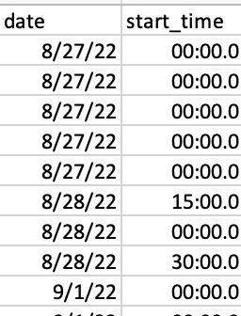
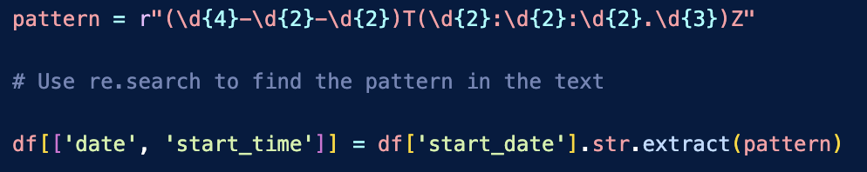
Data Preprocessing
Formatting:
The timestamp had to be reformatted into a usable form (date and time as separate variables)
Further extraction:
Box scores for home and away teams had to be separated into Q1, Q2, Q3, and Q4
Team records for total, conference, home, and away games extracted to their own column

Slide 7
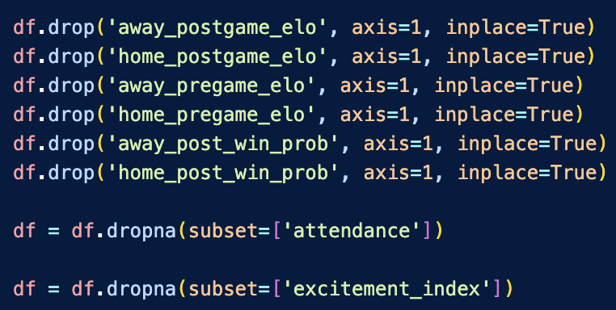
Data Preprocessing
Handling missing data:
‘Pre/Postgame elo’ and ‘Post Win Probability’ for home and away teams were removed due to missing entries
The dataset was refined to only include rows that are not missing ‘Attendance’ and ‘Excitement Index’
These variables are necessary

Slide 8
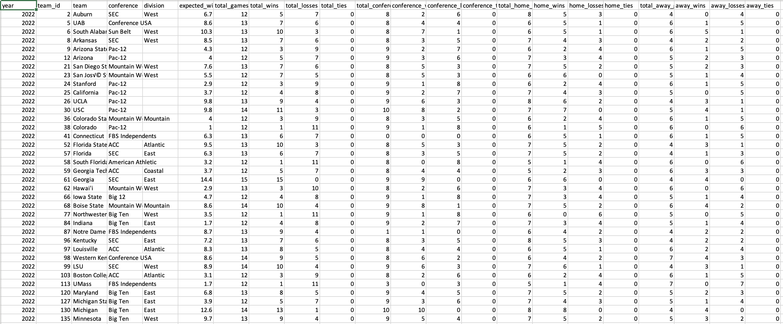
TeamsData.csv

Slide 9
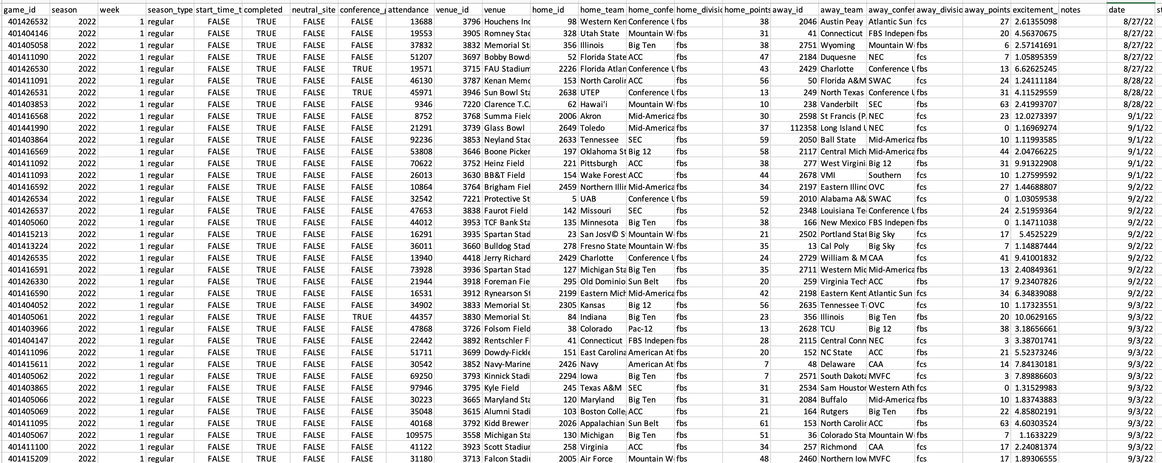
GamesData.csv

Slide 10

Distribution Approach
We aim to maximize accessibility and usability of the dataset
The data is provided in two CSV files:
‘GamesData.csv’ contains each individual game as a data row
‘TeamsData.csv’ contains each team as a data row
These files are meant to be used in conjunction to derive deeper insights
Accessibility is enhanced by providing detailed documentation (README file) that helps users navigate and use the data effectively

Slide 11

Access Rights
The dataset is available for educational, research, and analytical purposes
This promotes widespread use in these communities
Users are required to agree to the terms and conditions set by collegefootballdata.com
This includes restrictions on commercial use and redistribution
Commercial entities may require special permissions/licenses for uses involving monetization

Slide 12
Issues and Limitations
Absence of key variables: the lack of key variables impact the extent of available insights
Team rankings
Revenue data
Incomplete records: missing data limits the accuracy of any analysis
Specifically, dealing with missing ‘Attendance’ and ‘Excitement Index’ entries caused the dataset to be much smaller
The ‘Notes’ variable has missing entries, but this is acceptable
Any entries are special occasions

Slide 13

Team and Contributions
Team members:
Caleb Miller
Hashim Afzal
Muhammad Hazrat
Our group worked collectively on all stages of the project
Data collection and preprocessing was lead by Caleb and Hashim
The README documentation was lead by Muhammad
The presentation was completed as a whole

Slide 14

Thank you!
Questions?
Feel free to email us:
Caleb Miller: cm3962@drexel.edu
Muhammad Hazrat: mh3852@drexel.edu
Hashim Afzal: ha695@drexel.edu

